Slide 1





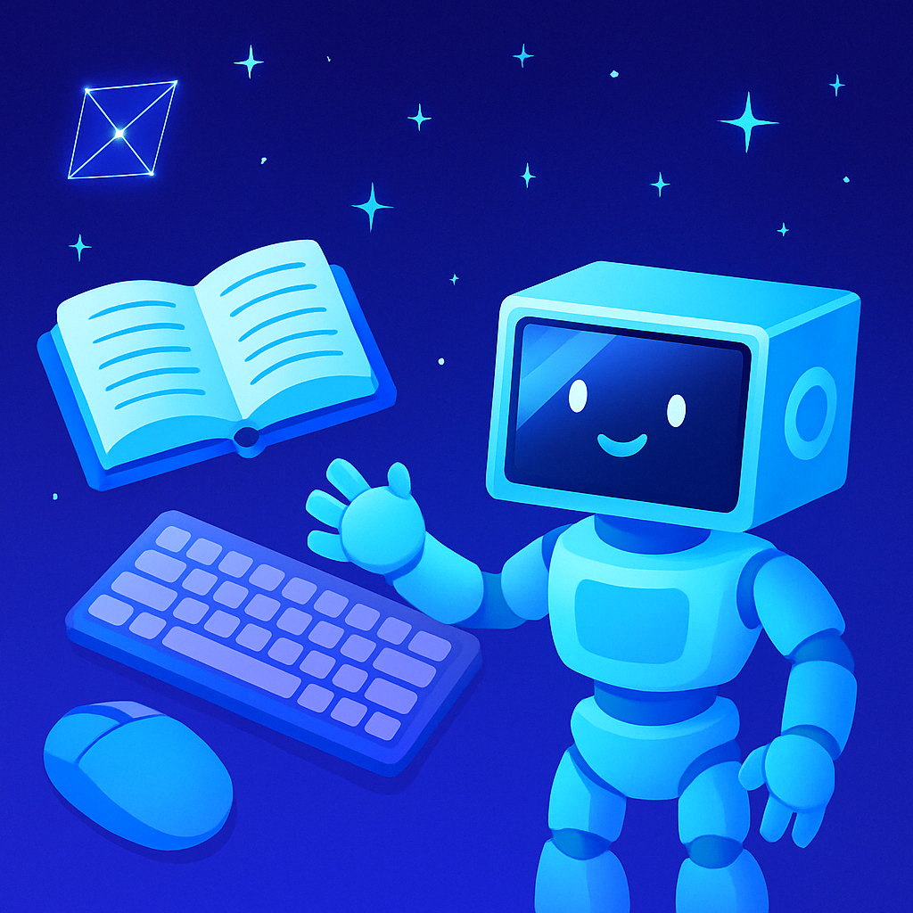


Final Year Project 2
TechTutor
Augmented Reality (AR) -Integrated Learning Application for Computer and Technology Use
Prepared By | : | Loh Chia Heung 23ACB01684
Supervisor | : | Dr Ng Hui Fuang
Moderator | : | Mr Tan Chiang Kang

Slide 2
TechTutor
Table of Contents
Chapter 1 :
Problem Statement
Motivation
Objectives
Project Scope
Contribution
Chapter 4 :
System Design
Chapter 5 :
System Demonstration
Chapter 6 :
Objectives Evaluation
Project Challenges
Chapter 2 :
Literature Review
Chapter 3 :
System Methodology
Chapter 7:
Conclusion

Slide 3



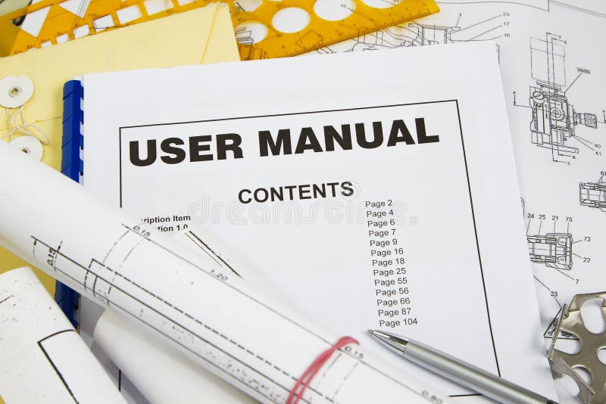

Problem Statements
Chapter 1
TechTutor
2
Basic Skills Challenge
Tasks like Email [7] and Microsoft Word [5] remain confusing without step-by-step help.
3
1
Existing Teaching Method
Digital Literacy Gap
Beginners/older adults face difficulties using technology due to lack of simple guidance [1].
Traditional teaching / videos are passive, lacking interactivity and engagement [9].

Slide 4



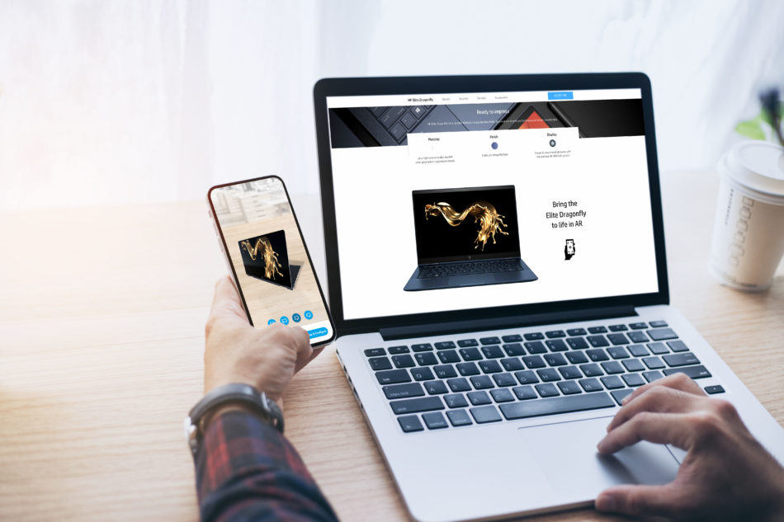
Motivation
Chapter 1
TechTutor
2
Interactive & Contextual Learning
AR overlays on real worlds, improving engagement and motivation [10].
3
1
Simplified AR-Based Tutorials
Provide Smart, Adaptive Support
Step-by-Step on-screen guidance
TTS Narration
Clear Visuals
Support different learning speeds, styles, and levels of digital experiences

Slide 5
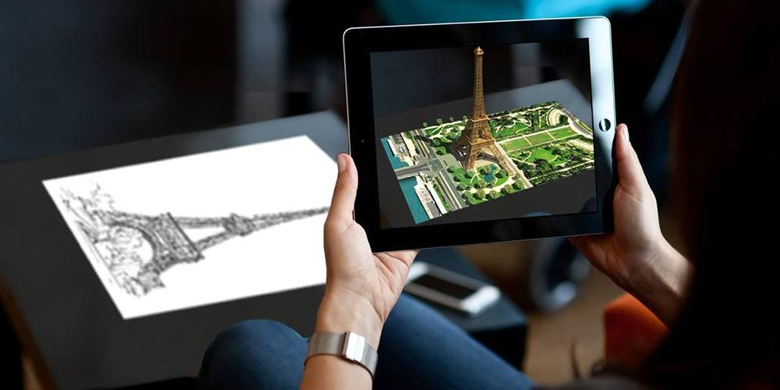
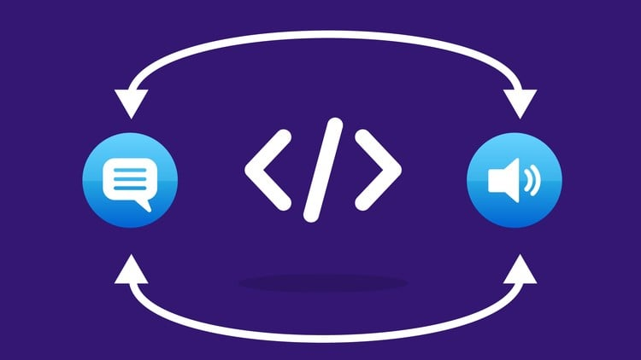
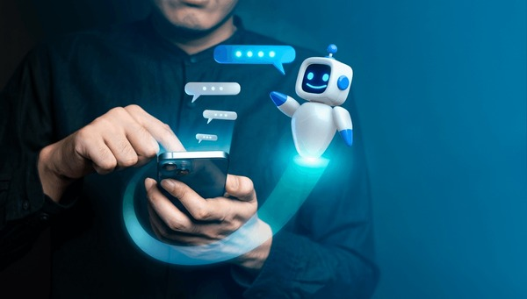
🎯 Objectives
Chapter 1
TechTutor
2
Develop an AI Tutor
Offer concise text/image Q&A with step guidance and keyword highlighting.
1
3
Develop AR-Based Learning Modules
Implement Adaptive Learning Features
Provide tutorials using AR and AI for basic computer skills and technology.
STT, TTS
Dual viewing modes
Local history for review

Slide 6










Project Scope
Chapter 1
TechTutor
3 Main Modules:
1. AR Learn :
AI Identify, AR Models, AR Quiz
2. AR Guide :
Step-by-step tutorials for Email, Microsoft Word, Snipping Tool, Calculator
3. AI Tutor :
Text/Image Q&A, EasyOCR keyword highlight
Voice & Audio: Speech-to-Text (STT), Text-to-Speech (TTS)
Modes & UI: 3D AR Mode (Virtual Desk Simulation Model) and Canvas Mode
Local Storage
OpenAI API

Slide 7


📄 Contributions
Chapter 1
TechTutor
1. AR + AI for Digital Literacy
Applies AR and AI to basic computer education.
Creating an immersive learning experience.
2. End-to-End Learning Workflow
Integrates AR Learn → AR Guide → AR Quiz.
User recognize computer parts, follow step-by-step tutorials and do quizzes.
3. Personalized & Accessible Support
AI Tutor, STT / TTS, OCR Keyword Highlight
Support different speeds, styles and accessibility needs.
4. Bridging the Digital Divide
Makes basic tech skills approachable for beginners and older adults
Builds confidence and enabling more inclusive digital participation.

Slide 8
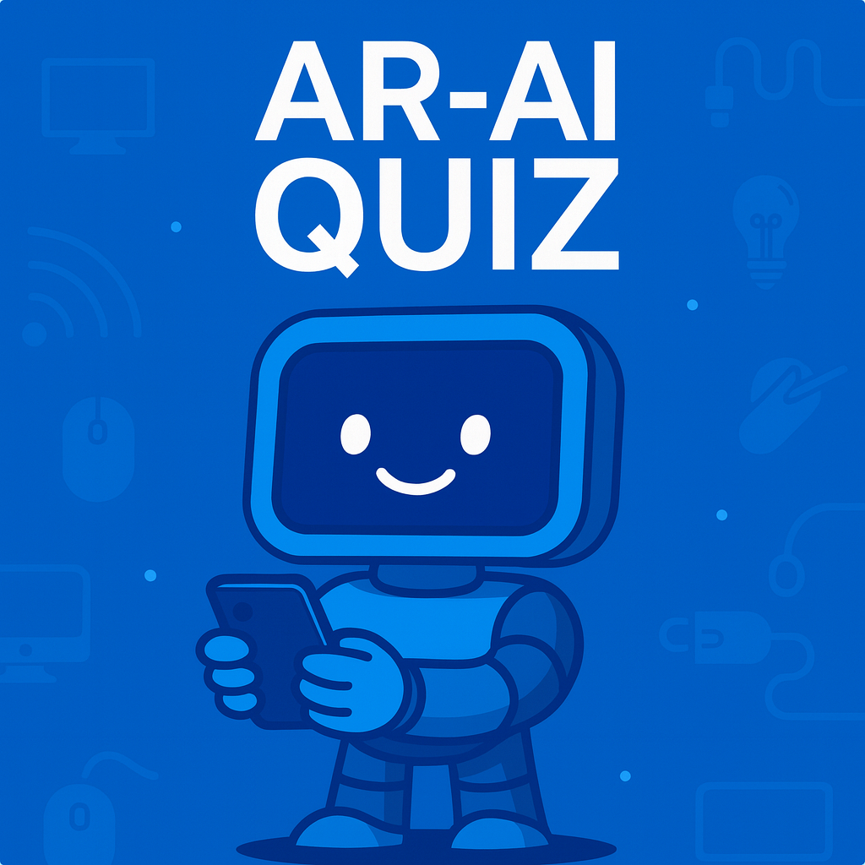

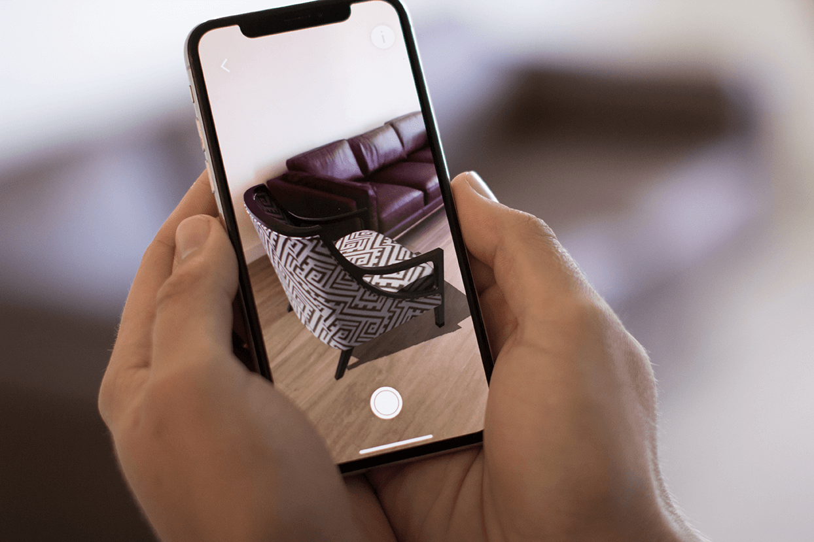

💡 Literature Review – Review of Technologies
Chapter 2
TechTutor
1. Augmented Reality (AR)
Enhances real-world environments with digital overlays (e.g., images, sounds, 3D models) [9][10].
AR Types:
Marker-based
Markerless
Project-based
Overlay AR
2. Optical Character Recognition (OCR)
Convert printed/handwritten/scene text into machine-readable text.
Pipeline:
Text Detection → Text Recognition
Modern DL Models:
CRAFT (Detection) + CRNN (Recognition)
In TechTutor, OCR helps the AI Tutor find and highlight the UI keywords in image.

Slide 9
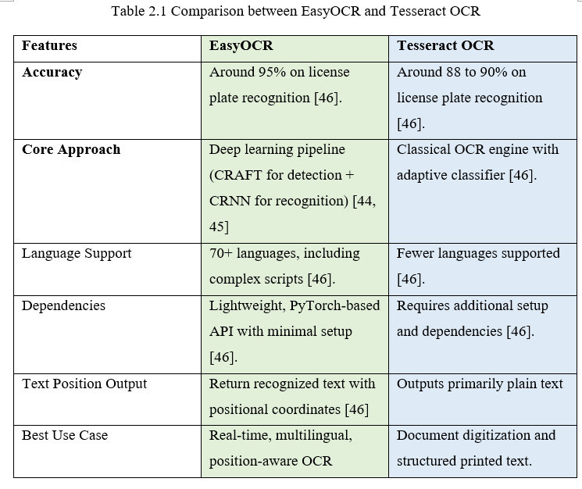
💡 Literature Review –EasyOCR
Chapter 2
TechTutor
Why EasyOCR?
Position-aware output: Returns text with coordinates → lets us highlight UI keywords on canvas precisely.
Robust modern pipeline: CRAFT + CRNN handles curved/rotated/scene text better than classic OCR.
Multilingual coverage: 70+ languages → inclusive for diverse users and content.
Lightweight & practical: PyTorch-based, minimal setup → suitable for real-time screenshot guidance.

Slide 10






💡 Literature Review – Existing Work
Chapter 2
TechTutor
Solution | Technology | Strengths | Limitations
Existing AR Apps (Quiver, Visible Body, ARChem, JigSpace, Assemblr EDU) | Marker-based / Markerless | Engaging 3D visuals Domain-focused learning | Passive/limited guidance Marker reliance Limited Customization Steep learning for beginners
TechTutor (Proposed Solution) | Dual AR: Markerless + Marker-based OpenAI EasyOCR STT/ TTS (Voice) | Step-by-step AR Guides AI Assistance OCR Highlights Seniors-friendly Reviewability 2 Modes Local History | Needs Internet for OpenAI Device Performance Varies

Slide 11



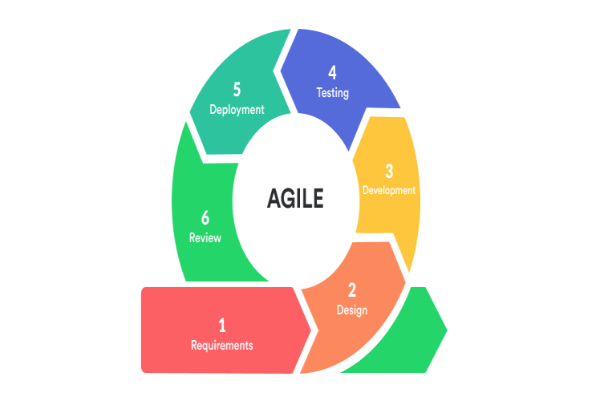

System Methodology
Chapter 3
TechTutor
Agile Methodology
Support Iterative Development
Adapts to Changing Requirements
Continuous Feedback
Early Testing and Issue Resolution
Modular Development Kit

Slide 12


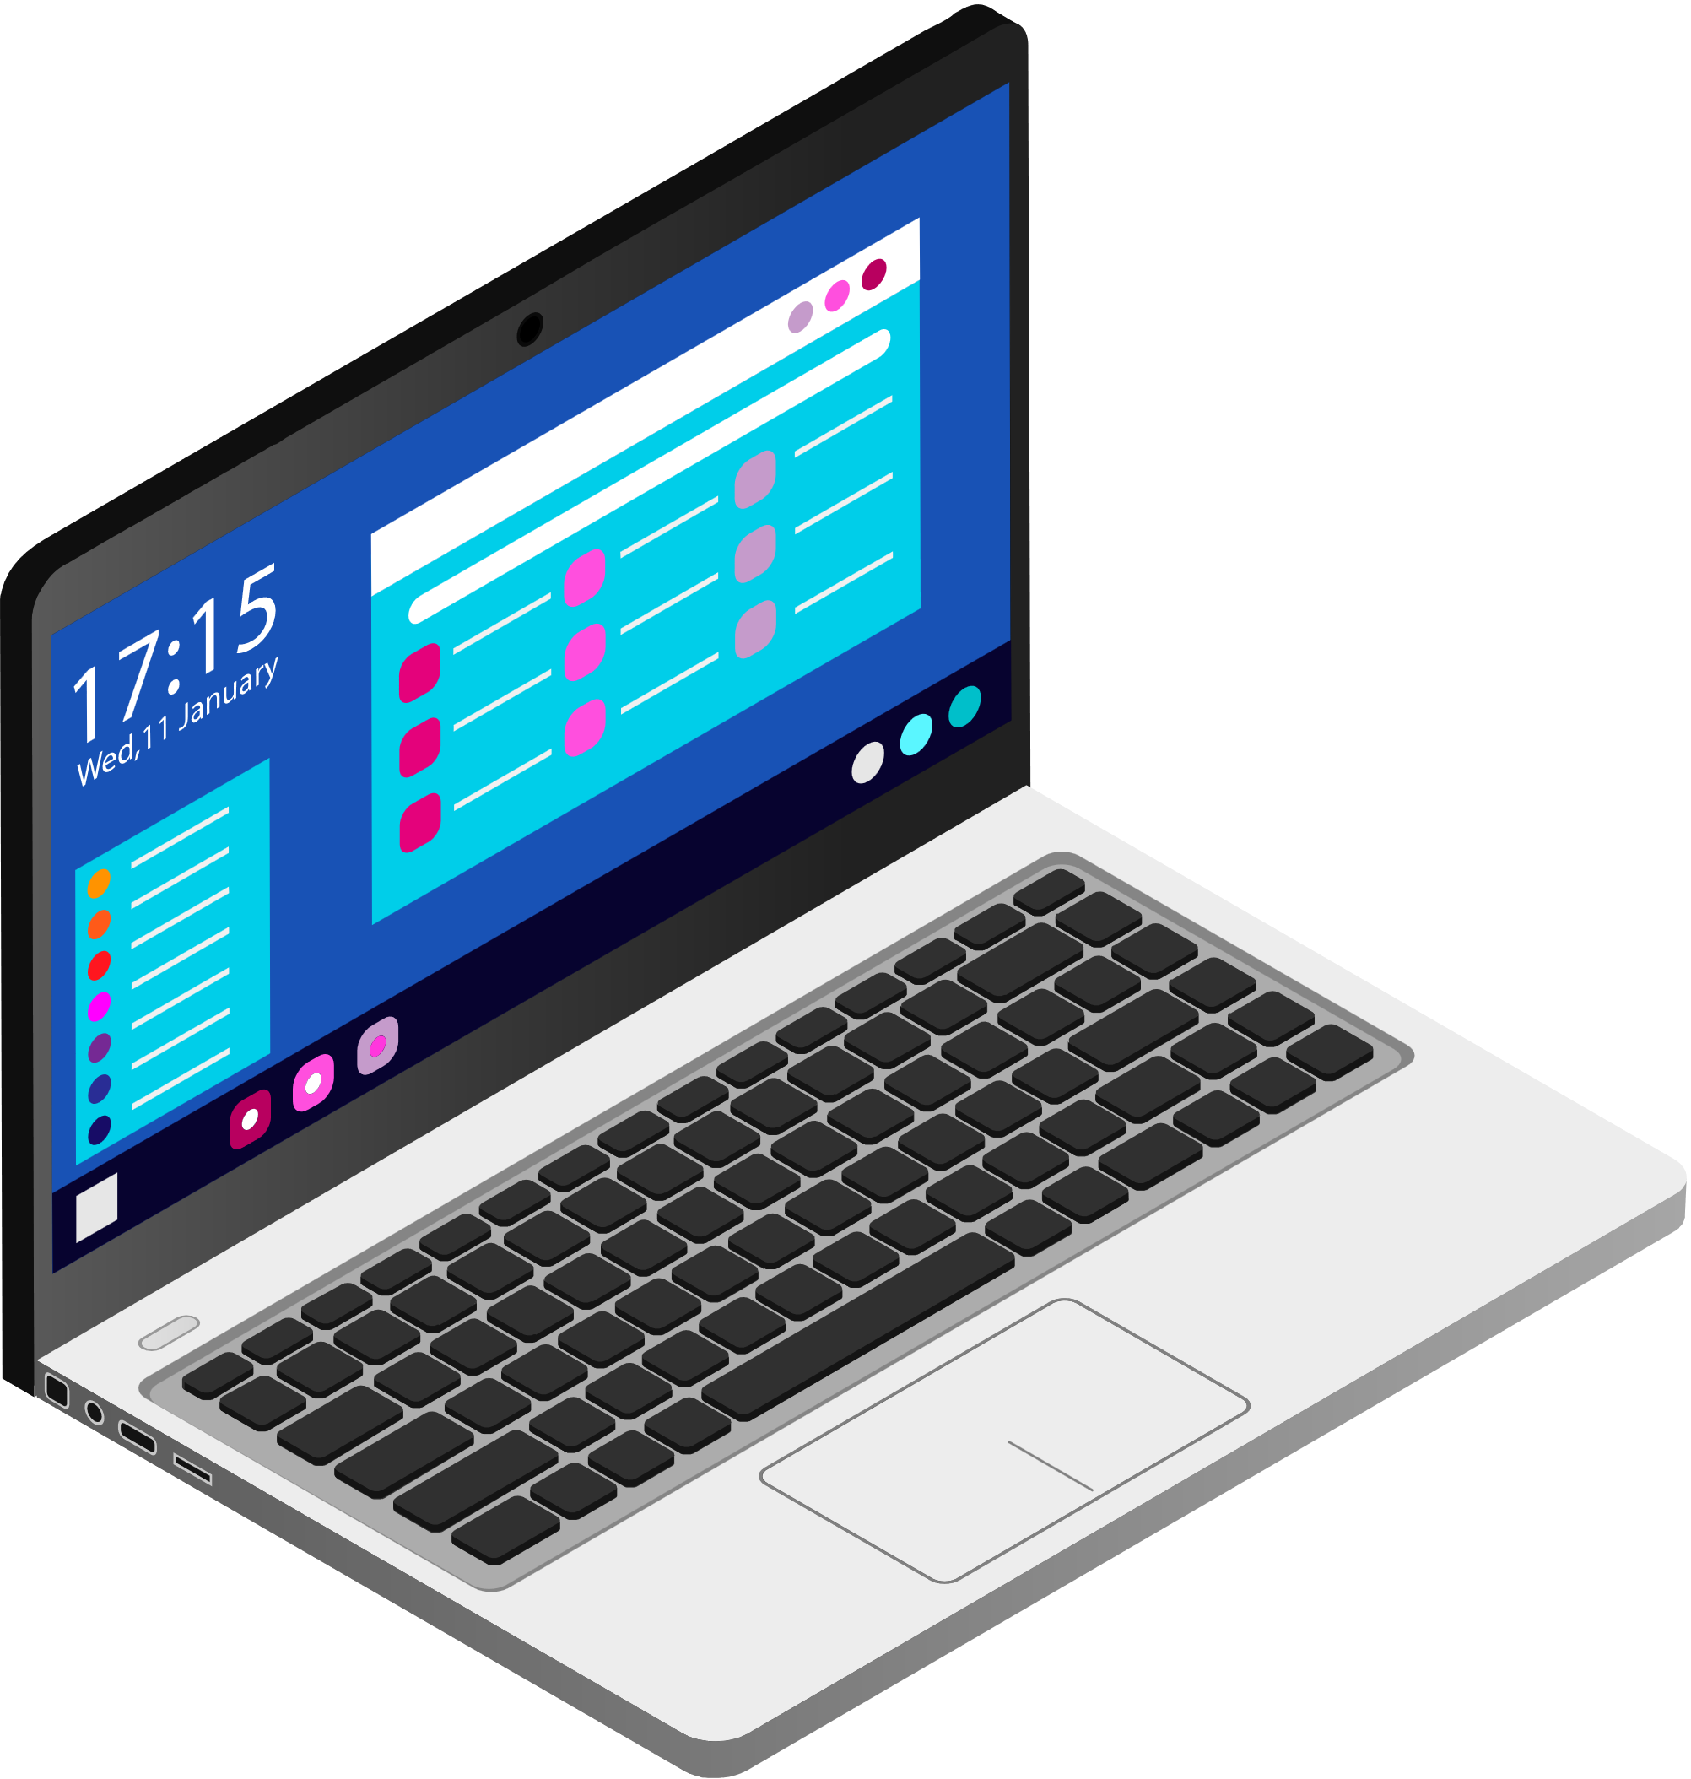


System Requirements
Chapter 3
TechTutor
👨🏻‍💻 Software
Hardware 🛠️
Unity 2022.3.57f1
Vuforia Engine
ARCore XR Plugin
Sketchfab
Figma
Android Studio
Meshy.ai
Android Smartphone
Laptop

Slide 13

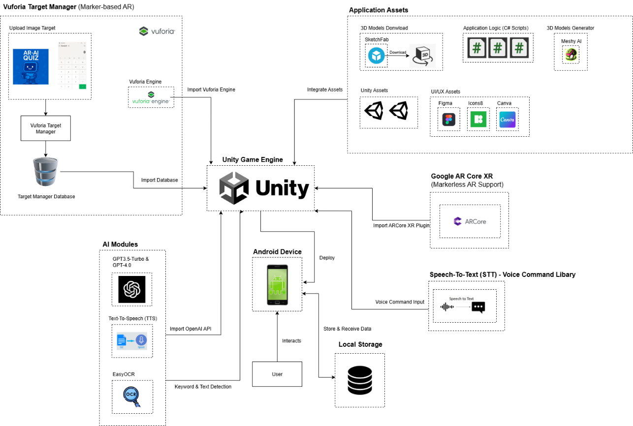
System Design
Chapter 4
TechTutor
System Architecture
Client (Unity, Android)
AR Foundation + ARCore
Vuforia Engine
AI & OCR
OpenAI
TTS, STT
EasyOCR
Assets & Logic
3D Models, C# Scripts, Unity Assets, etc.
Storage
Local: Quiz history, chatbot records, TTS audio files

Slide 14
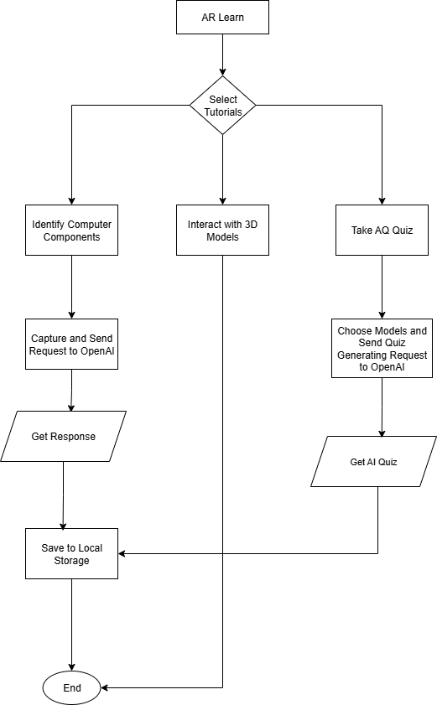

System Design
Chapter 4
TechTutor
System Flowchart – AR Learn
Choose: AI Identify / AR Models / AR Quiz
AI Identify: Capture → OpenAI Classify Computer Components → TTS → Save History
AR Models: Spawn on plane → Resize / Rotate / Move → Tap labels → Info Panel
AR Quiz: Marker detected → OpenAI generates questions → Answer / regenerate → TTS → Save Quiz audio & results

Slide 15
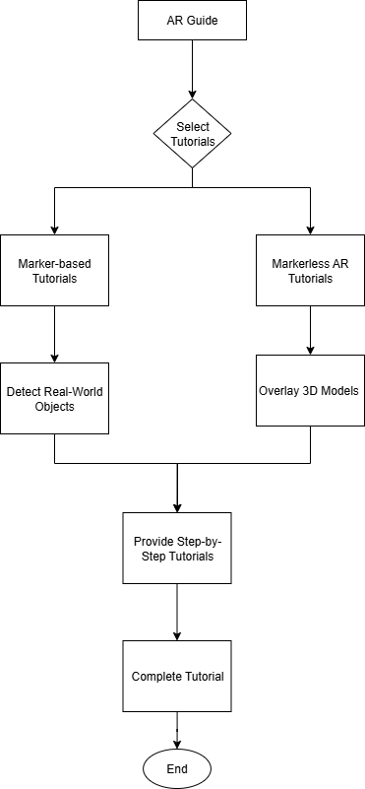

System Design
Chapter 4
TechTutor
System Flowchart – AR Guide
Select Tutorial : Marker-based (Detect calculator) / Markerless (Detect plane, overlay 3D models)
Step engine shows instructions + TTS narration and STT “Next / Previous”
Visual highlight on keyboard / mouse / monitor.
Progress & Audio saved to local storage.

Slide 16
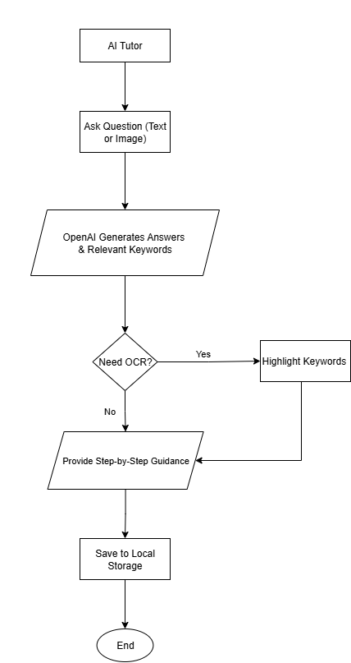

System Design
Chapter 4
TechTutor
System Flowchart – AI Tutor
Text or Image question → OpenAI return concise 3-5 steps.
If image: EasyOCR gets keyword positions → Canvas highlight the keyword
Guidance shown on canvas
Conversation saved to local storage.

Slide 17
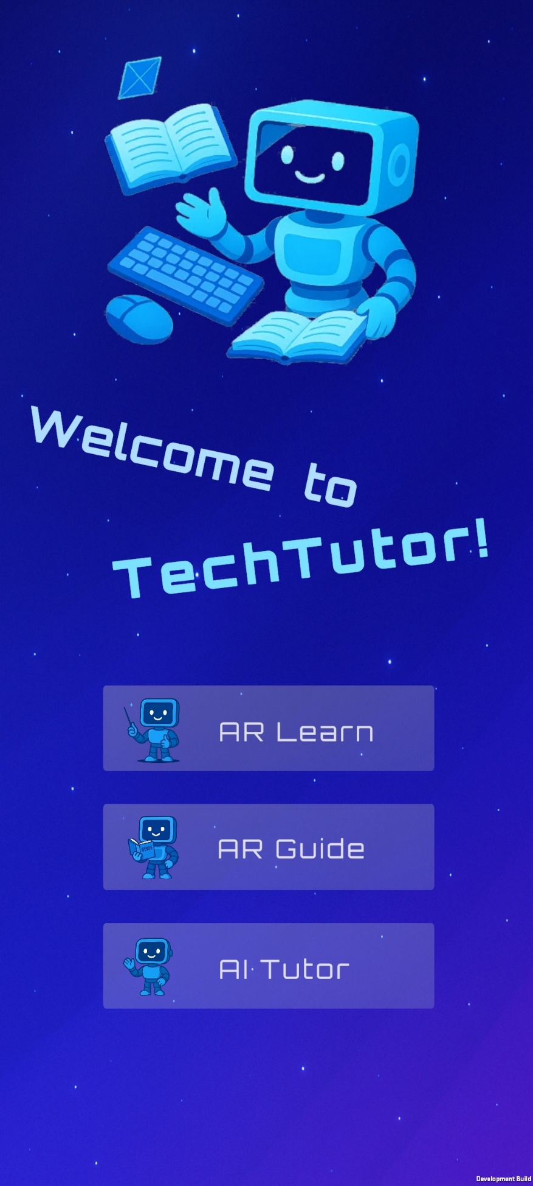
System Demonstration
Chapter 5
TechTutor
Proceed to
Project
Demonstration

Slide 18

🎯 Objectives Evaluation
Chapter 6
TechTutor
1
2
3
Develop AR-Based Learning Modules
Develop an AI Tutor Module
Implement Adaptive Learning Features
AR Learn Module (AI Identify, AR Models, AR Quiz)
AR Guide Module (Email, Word, Snipping Tool, Calculator
Support text and image queries with concise 3-5 steps answers.
EasyOCR extract keywords and highlight the relevant keywords.
TTS for narration / review
STT enables hands-free next / previous navigation.
Dual Viewing Mode (3D AR / Canvas)
Accessibility for beginners and older adults.

Slide 19
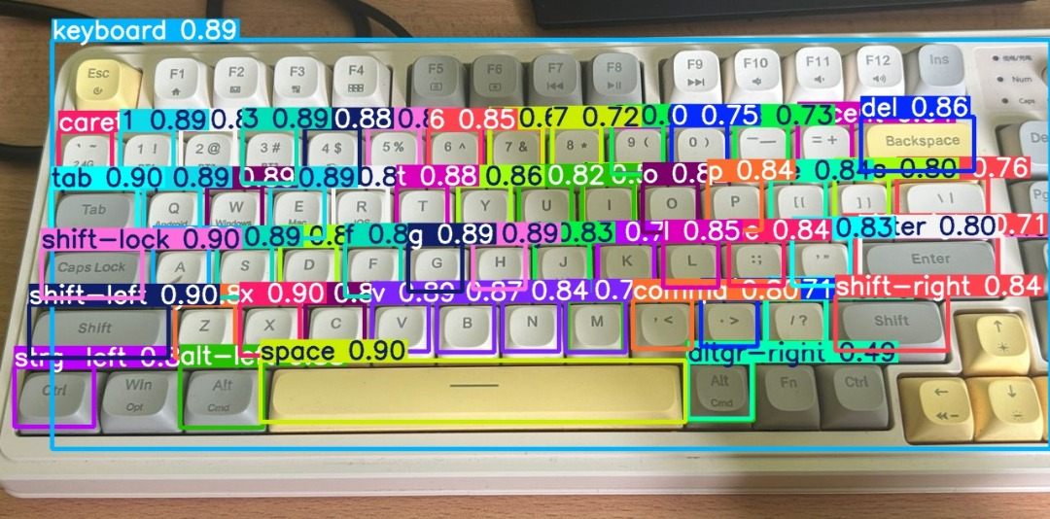
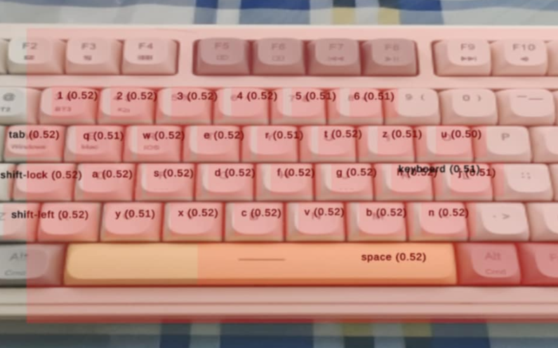
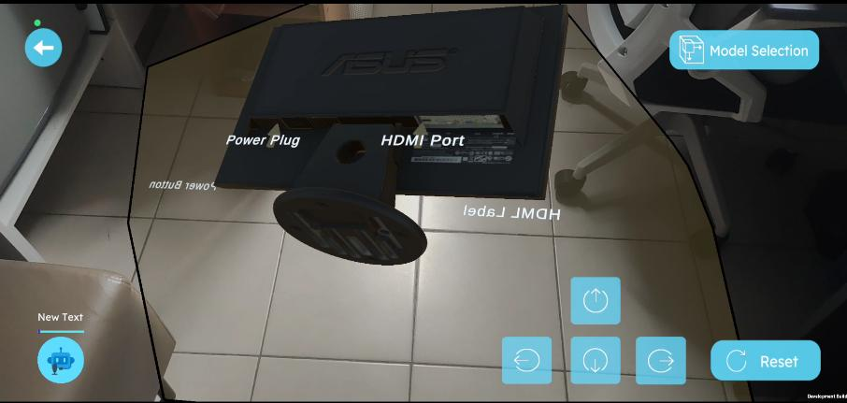
⚠️ Project Challenges
Chapter 6
TechTutor
1
Real-time detection confidence only 0.5 – 0.7 (Unreliable recognition)
Added mobile lag → Poor UX
Decision: Switch to OpenAI-based Identify
Model Performance & Confidence (YOLOv5)
2
Drift / bad anchoring under low light, featureless surfaces, fast motion
Unity Scene looked fine, on-device testes exposed issues.
Required extensive testing & calibration
AR Misalignment in Real Environment

Slide 20
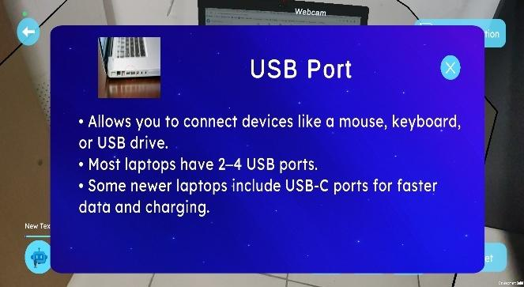
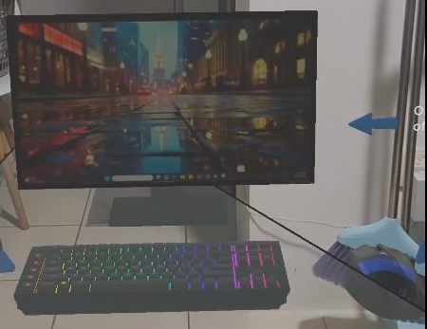
⚠️ Project Challenges (Cont.)
Chapter 6
TechTutor
3
Guiding on a real laptop screen is hard
Camera sees blur / AR can’t “read” the screen reliably. Interface keeps updating and changing from time to time.
Tutorials are made for specific tasks. Need future development for new tasks.
Limited ‘Generalization’ in AR
Reusable model pattern
Use a standard template for models (drop in and add labels, then done)
Virtual desk
Teach on a virtual keyboard / mouse/ monitor with TTS voice.
Update only monitor screens
New tutorials → Reuse the same desk model, just change the screen and steps.
Solution

Slide 21
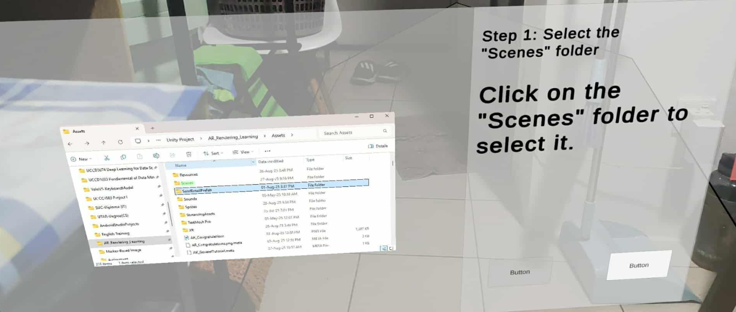
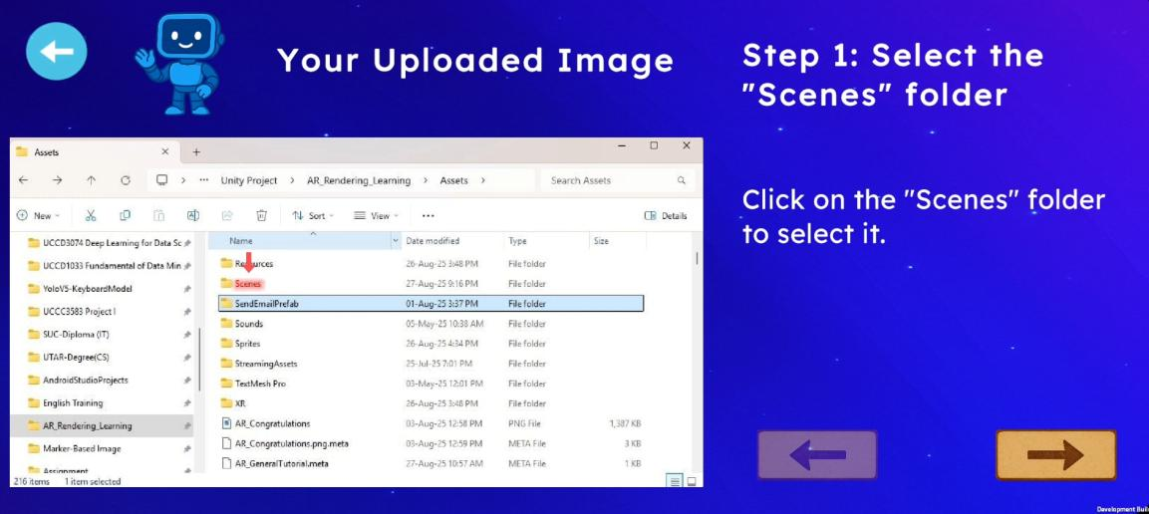
⚠️ Project Challenges (Cont.)
Chapter 6
TechTutor
4
Blurred Image in real world (AI Assistance)
Change to Canvas Mode (2D)
No AR needed

Slide 22
🏁 Conclusion
Chapter 7
TechTutor
Objectives Met
Build TechTutor (AR + AI)
Delivered Modules
AR Learn, AR Guide, AI Tutor with STT / TTS and OCR highlights.
Outcome
Interactive, step-by-step, AR learning, support different learning speeds, saves histories for review.
Impact
Bridge the digital divide.
Potential Development
Expand tutorials and strengthen offline / multilingual support.

Slide 23
📑 Reference
Reference
TechTutor
[1] A. Smith, “Older Adults and Technology Use,” Pew Research Center: Internet,
Science & Tech. https://www.pewresearch.org/internet/2014/04/03/olderadults-and-technology-use/ (accessed: Aug. 6, 2024)
[5] N. Charness, C. L. Kelley, E. A. Bosman, and M. Mottram, “Word-processing
training and retraining: Effects of adult age, experience, and interface.,” Psychology and Aging, vol. 16, no. 1, pp. 110–127, 2001, doi: https://doi.org/10.1037/0882-7974.16.1.110. [7] S. Almeida-Ferreira, A. I. Veloso, and O. Mealha, “Older Adults and Email Use: The challenges facing interface co-design,” Networking Knowledge: Journal of the MeCCSA Postgraduate Network, vol. 10, no. 1, pp. 44–63, Mar. 2017, doi: https://doi.org/10.31165/nk.2017.101.496. [9] M.-B. Ibáñez and C. Delgado-Kloos, “Augmented reality for STEM learning: A systematic review,” Computers & Education, vol. 123, pp. 109–123, Aug. 2018, doi: https://doi.org/10.1016/j.compedu.2018.05.002. [10] M. Akçayır and G. Akçayır, “Advantages and challenges associated with augmented reality for education: A systematic review of the literature,” Educational Research Review, vol. 20, no. 1, pp. 1–11, Feb. 2017, doi: https://doi.org/10.1016/j.edurev.2016.11.002.

Slide 24
Final Year Project 2
TechTutor
Thank You!

